Slide 1
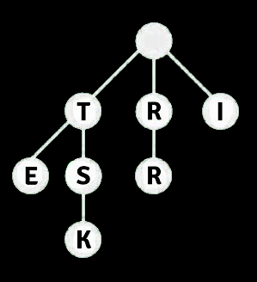
Prefix Trees : Real-world Application of Tries in Solving Data and Algorithmic Challenges
DAA : Demo Presentation
Presentation By:
MD Rakiul Islam (RA2211033010129)
Saransh Bangar (RA2211033010093)
Dev Karan Singh (RA2211033010092)

Slide 2
The Trie data structure :
P
A Trie (pronounced "try") is a tree-like data structure used to store a dynamic set of strings where the keys are usually strings themselves. It's particularly efficient for searching for strings.
The given diagram shows how the words “POT”, “PAST” , “PASS” and “PART” would look like in a Trie Data Structure.
O
A
T
S
R
T
S
T

Slide 3
Advantages of using Trie :
Efficient prefix search for autocomplete and predictive text.
Space-efficient storage, especially for words with common prefixes.
Fast lookup operations with O(m) complexity.
Supports ordered iteration of words.
Suitable for storing and retrieving complex keys.

Slide 4
Disadvantages of using Trie :
Significant memory overhead, especially for sparse data.
Slower insertion and deletion compared to some data structures.
Not suitable for numeric data.
Complex implementation and management of pointers.
Limited applicability beyond string-based data and prefix operations.

Slide 5
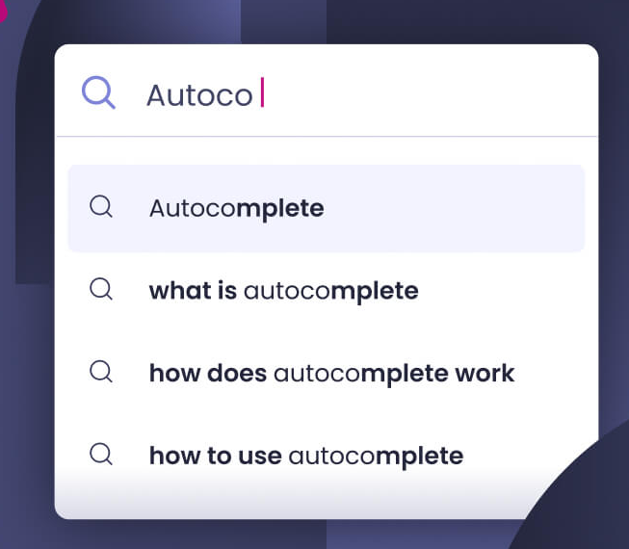
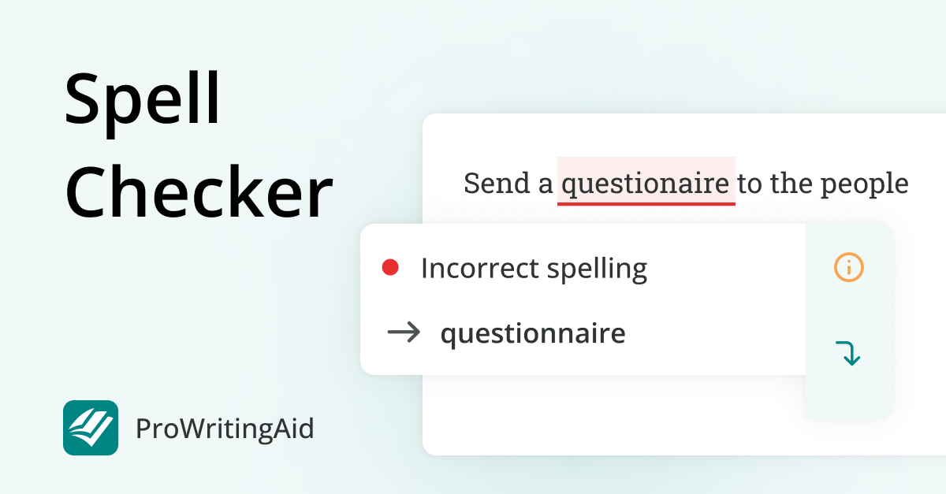
Real-Life Application :
Predictive Text
Spell Checkers

Slide 6
Implementation of a Trie :
Representation of individual Trie nodes:
class TrieNode {
public:
unordered_map<char, TrieNode*> children;
bool isEnd;
TrieNode() : isEnd(false) { }
};
Representation of the Trie class:
class Trie {
private: TrieNode* root ;
public:
Trie() { root = new TrieNode(); }
void insert ( const string& word ) {...}
bool search ( const string& word, int& iterations ) {...}
};

Slide 7
Operations on a Trie :
Inserting a Node:
void insert(const string& word)
{
TrieNode* current = root;
for (char ch : word)
{
if (current->children.find(ch) == current->children.end())
{
current->children[ch] = new TrieNode();
}
current = current->children[ch];
}
current->isEnd = true;
}
Searching a Node:
bool search(const string& word, int& iterations)
{
TrieNode* current = root;
for (char ch : word)
{
iterations++;
if (current->children.find(ch) == current
->children.end())
{
return false;
}
current = current->children[ch];
}
return current->isEnd;
}
Time Complexity : O(n)
Time Complexity : O(|m|)

